Slide 1
A Python-Based Code Linting and Error Explanation System Using Pylint and AI Integration
BUGBOT
Authors:
Aniruddhan S
Department of Information Technology Manipal University Jaipur
Manav Singh Department of Information Technology Manipal University Jaipur

Slide 2
Why Bugbot?
There are a dozen AI models out there, which make lives of people especially Engineers easy. How?
Here’s how, when a student has a problem with code, he/she immediately uses an LLM to fix it. Now the student gets a fix for this particular issue by solving the problem but does the student learn form the mistake made by them.
BugBot unlike other LLMs focuses on providing a detailed human readable code review with step-by-step instructions to fix it without providing the rectified code itself. This allows the student to focus on the concept used to resolve the issue.

Slide 3
What helped us make bugbot?
After careful and tedious research, we found a ton of helpful libraries that do the job.
The process of cleaning and rectifying code is called as Linting, and libraries which Lint code are called as Linting Libraries. Now we had looked into a few Linting Libraries such as:
Abstract Syntax Tree -- Not used in the project as the library was outdated and wasn’t as helpful as the rest.
Pylint – One of the best linting libraries and also performs the functionalities required for the project perfectly.
Flake8 – Also a good library but not as good as Pylint in some scenarios.
Considering the advantages of Pylint, we went ahead with Pylint to be a linting library in our project

Slide 4
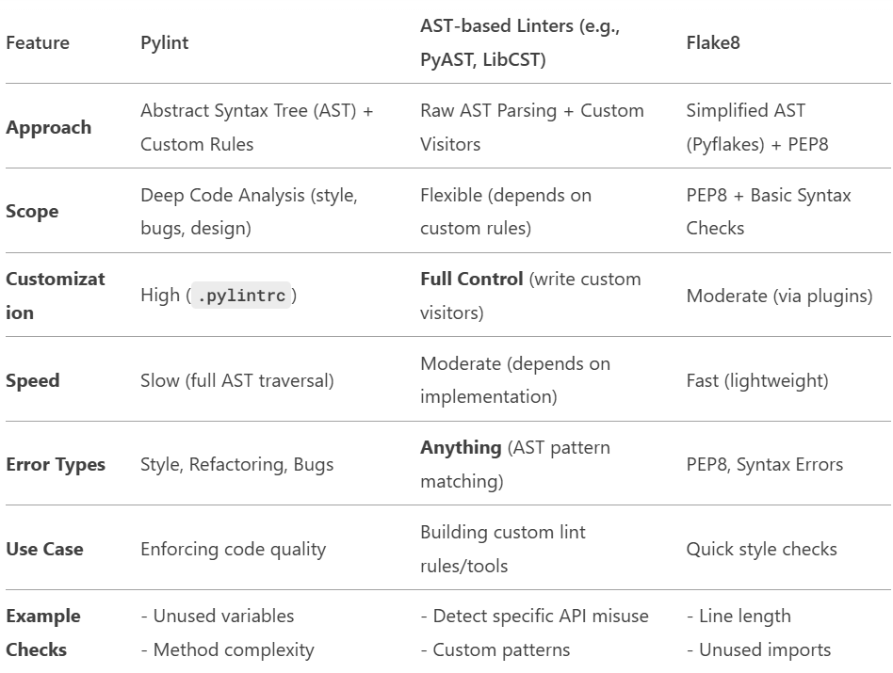
A comparison of linting libraries

Slide 5
How did we choose the right llm?
Choosing the right LLM for the project is a very tricky, there are thousands of LLMs which are available for code revie automation but we still went ahead with a few options that we thought were best given the functionality and keeping in mind about future aspects we had a list of the best fit LLMs for the project:
CodeTransOcean: This LLM is based on the t5-small model. It has its own Sentence Piece vocabulary model. It used single-task training on source code summarization python dataset. The model could be used to generate the description for the python function or be fine-tuned on other python code tasks. It can be used on unparsed and untokenized python code. However, if the python code is tokenized, the performance should be better.
CodeGen2: CodeGen2 is capable of extracting features from given natural language and programming language texts, and calculating the likelihood of them. However, the model is intended for and best at program synthesis, that is, generating executable code given English prompts, where the prompts should be in the form of a comment string. The model can complete partially-generated code as well. CodeGen2 is also used for Infill which fills missing code and does not contribute much to resolving errors and bug fixes.
CodeLlama(7b): Code Llama and its variants is intended for commercial and research use in English and relevant programming languages. The base model Code Llama can be adapted for a variety of code synthesis and understanding tasks, Code Llama - Python is designed specifically to handle the Python programming language, and Code Llama - Instruct is intended to be safer to use for code assistant and generation applications.

Slide 6
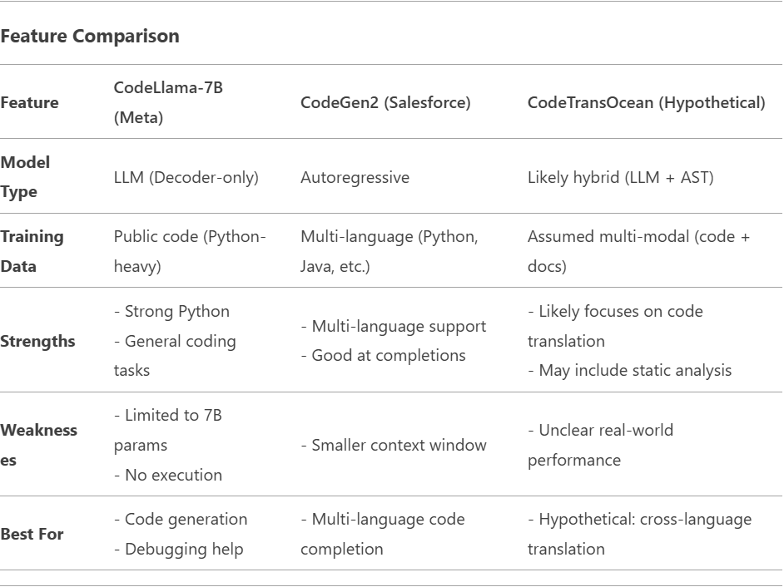
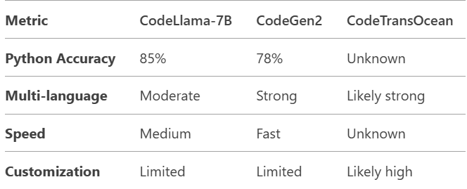
Comparison of the shortlisted LLm’s
COMPARING SPECIFICATIONS :

Slide 7
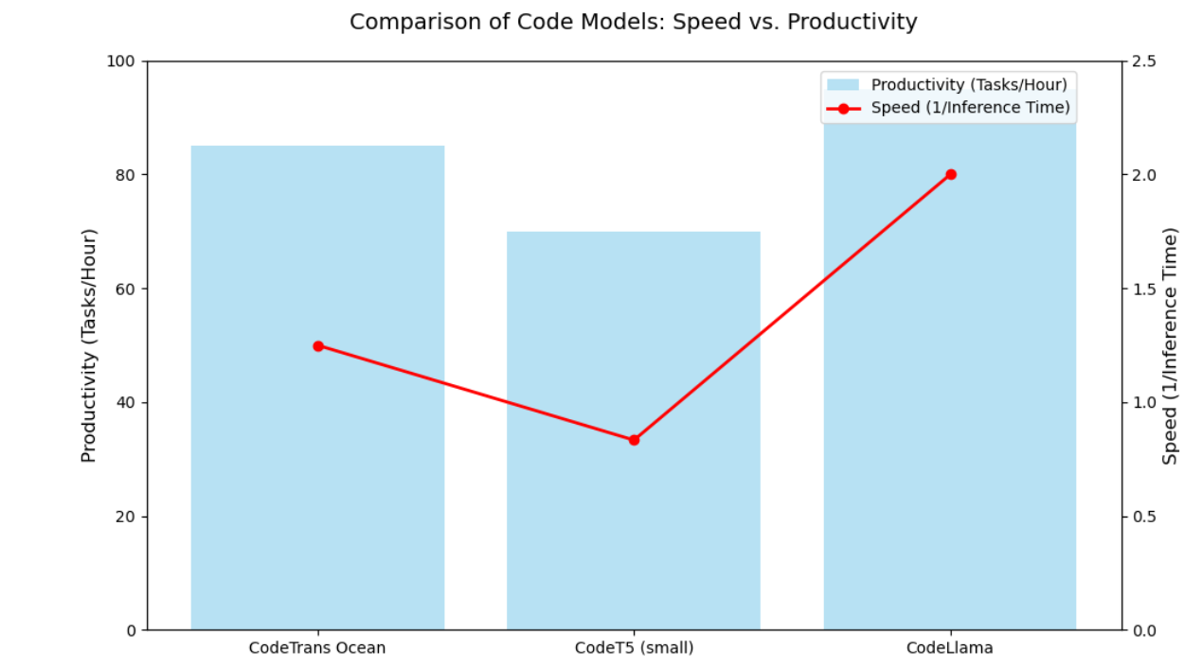

Slide 8
Choosing the right model
Considering the facts given above the best fit LLM would Code Llama(7b) as it satisfies all the criteria.
CodeTransOcean too would do a good job and would do well in the project but the LLM requires larger Machine specifications to run on and due to the lack of the above-mentioned specs we had to choose the next best LLM and that would be Code Llama.
WHAT IS CODE LLAMA(7b)?
Code Llama is a library of Ollama, Ollama is a very well known LLM and is used widely in chatbot applications, now CodeLlama is a library of Ollama that caters exclusively to the needs of coding and nothing else.
Code Llama has in built varieties too:
Code Llama: base models designed for general code synthesis and understanding
Code Llama - Python: designed specifically for Python
Code Llama - Instruct: for instruction following and safer deployment
Now considering our needs we have chosen Code Llama – Instruct as we needed our program only to provide instructions to fix code and provide snippets of corrected code only if required.

Slide 9
Choosing the right model
Code Llama is a library of Ollama, Ollama is a very well known LLM and is used widely in chatbot applications, now CodeLlama is a library of Ollama that caters exclusively to the needs of coding and nothing else.
Now that we have an idea of what Ollama is and its types we shall dive a bit deeper and also make use of the tiniest possible LLM’s provided by it in order for us to make a smooth application.]
TinyLLama, this is another Ollama LLM which does a tremendous job only while using 1.1B parameters, cool right!
So, considering its strength and also how it works smoothly in API fetches we thought of using TinyLLama in our project as it would be the best fit.

Slide 10
Future Prospects:
Now considering the fact that we have used the best resources and models, it does not mean we cannot improve what we can do with better resources.
So, if our project requires Future Prospects, it would be providing better resources to make it a better application.
Integrating the application with flake8 would also allow programmers to improve quality of code by following PEP8 which not only makes code cleaner but also organised.
Adding the CodeTransOcean LLM to the application would make our application much better. However running CodeTransOcean offline is a tedious task. How would it make our application better then?
CodeTransOcean is a remarkable LLM that allows us to Cache it i.e., it allows us to add another LLM that runs offline into it, for e.g.: integrating Code Llama into CodeTransOcean would make it accessible offline and a better fit for the application.
There is a better learning curve for a student with a teacher understanding where the student is struggling, now we have planned a LAN based proctoring mechanism which composes of multiple computers that are connected in the LAN and it also makes sure that the proctor computer has an overview of the errors being generated in each computer. Now this was not possible to accomplish given the time constraint.

Slide 11
THANK YOU

